Slide 1


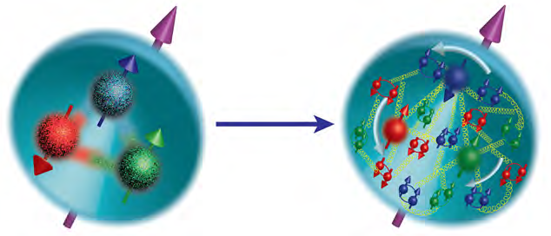
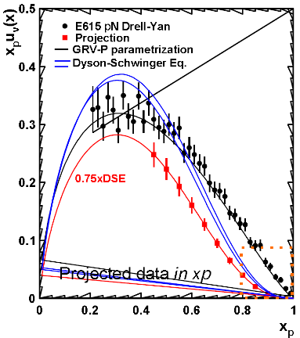
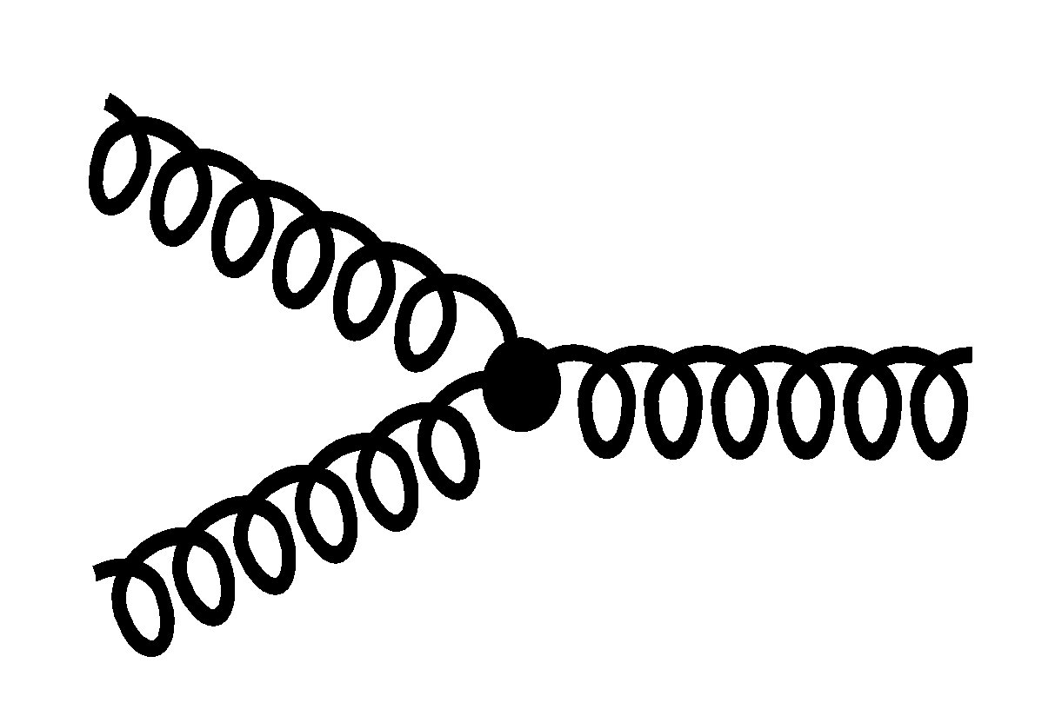
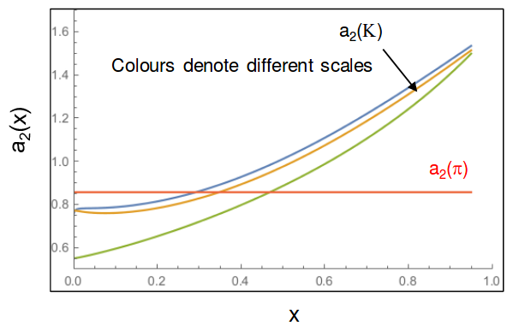

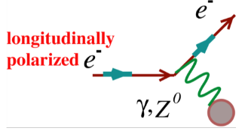
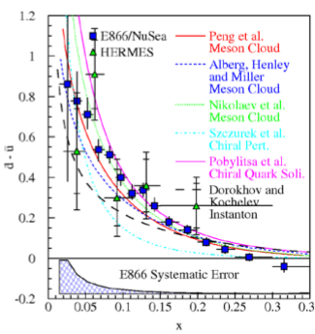
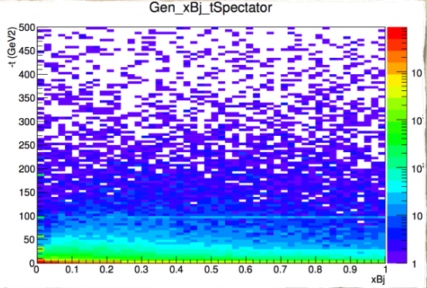
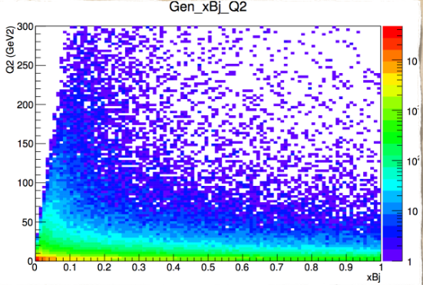
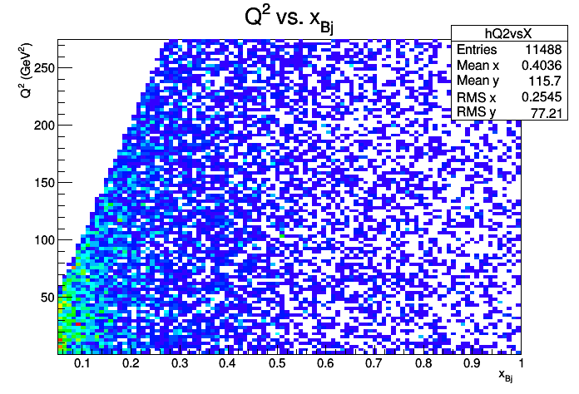
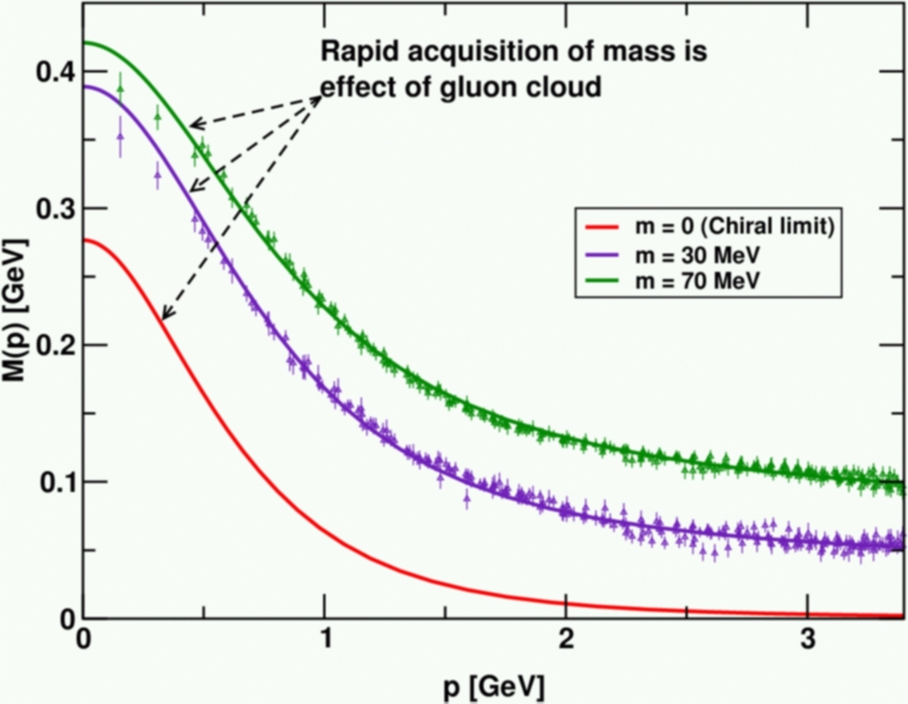
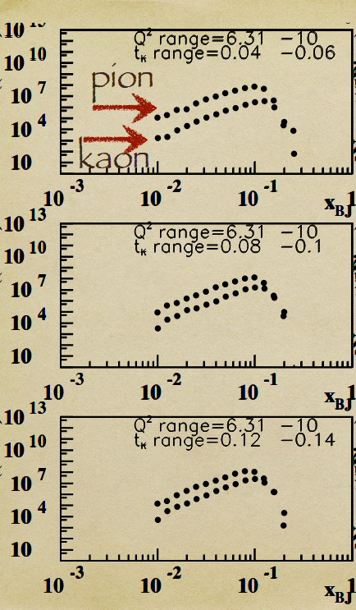
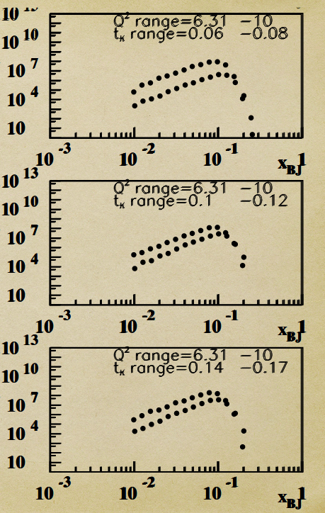
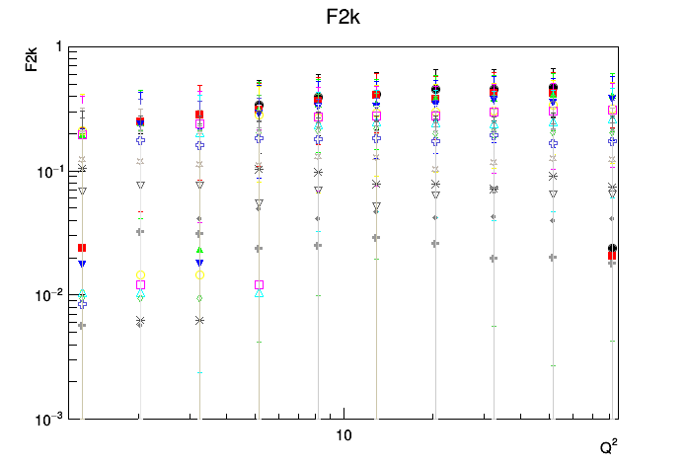
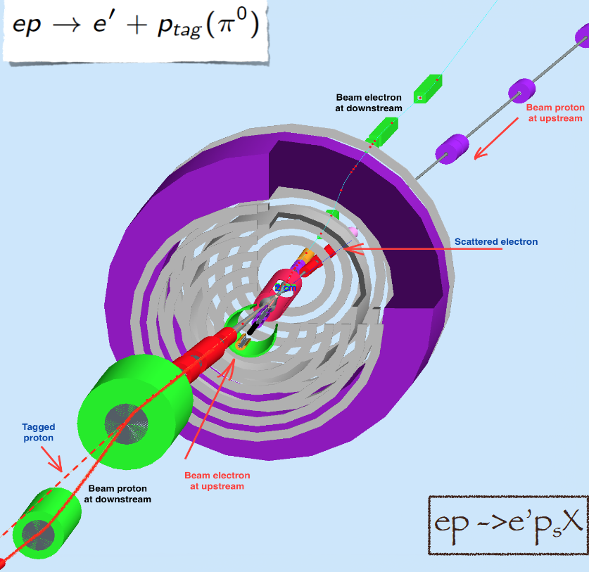
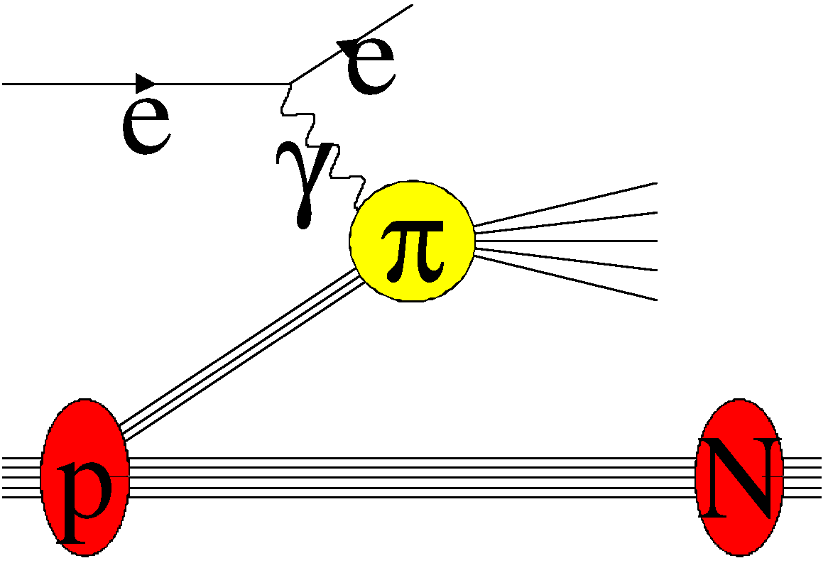
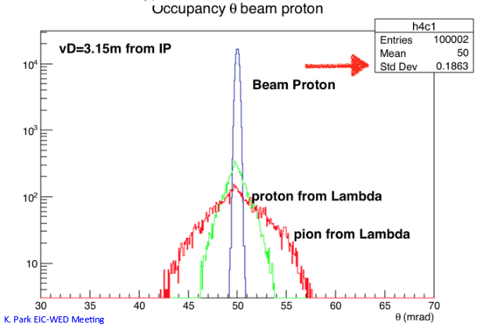

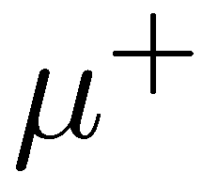

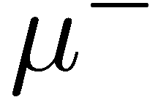
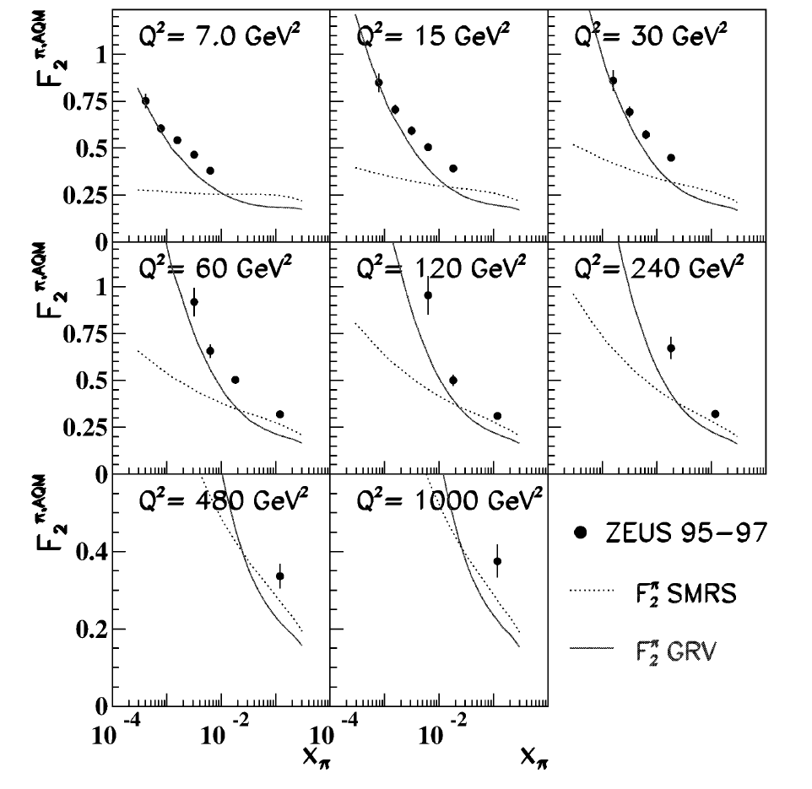
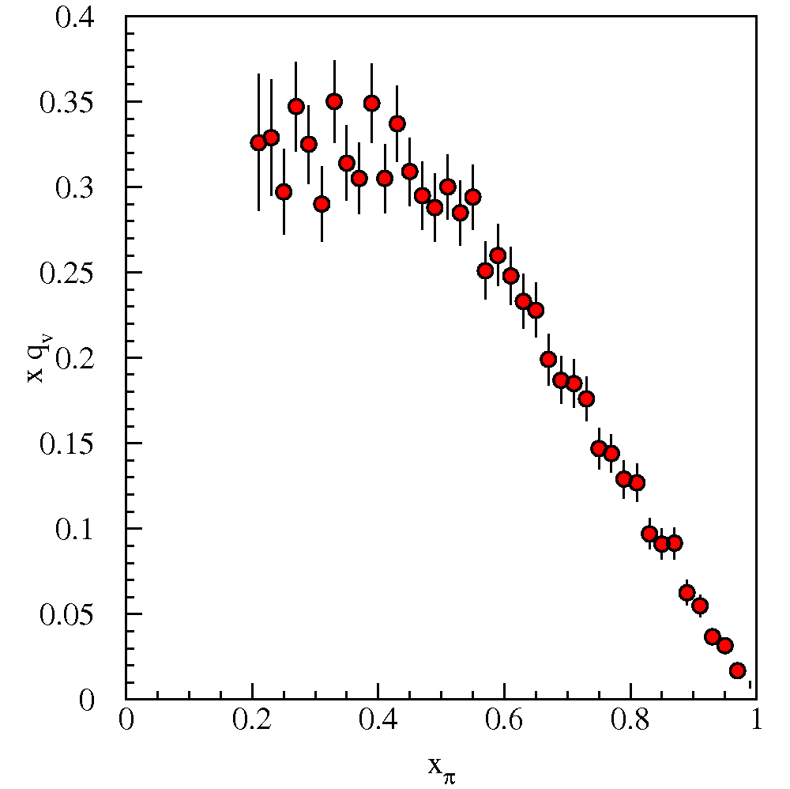
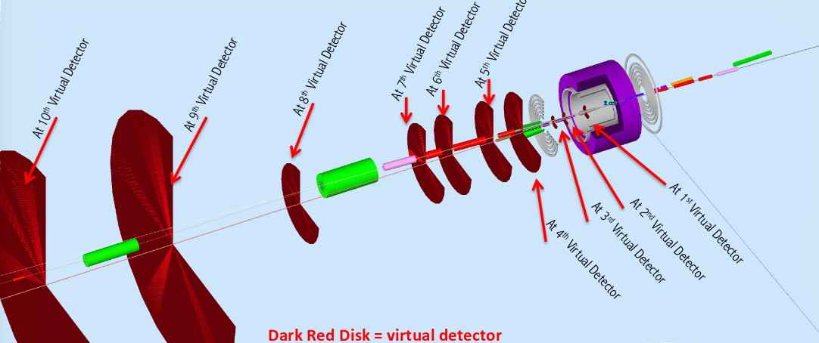
Simulations for Pion and Kaon Structure Functions
The Catholic University of America
Richard L. Trotta III
QCD Science Questions
Interest in Pion/Kaon Structure Functions – quarks and gluons
Considerations for Simulation
How are gluons and sea quarks, and their intrinsic spins distributed in space and momentum?
Implementing accelerator info
Beam emittances (ϵ^{n}_{e,i,}, β*_{e,i}) IP, Cross-angle: 5 mrad, [E_{e}xE_{D}]=[5x100] GeV², p_{R}<300 MeV
Longitudinal p and angular spread of the beam: dp/p=3x10⁻⁴, dθ=2x10⁻⁴
Codes are build in C⁺⁺ (phase-space) and ROOT v5.34.34
User inputs cross-section model, nucleon structure function, and deuteron wave function
At low x to moderate x, both the quark sea and the gluons are very interesting.
Are the sea in pions and kaons the same in magnitude and shape?
Is the origin of mass encoded in differences of gluons in pions, kaons and protons, or do they in the end all become universal?
What happens to the gluon density in nuclei at high energy? Does it saturate into a gluonic form of matter of universal properties?
At moderate x, compare pionic Drell-Yan to DIS from the pion cloud
test of the assumptions used in the extraction of the structure function and similar assumptions in the pion and kaon form factors.
Disentangling Flavor Dependence
How about the distributions of quarks and gluons in the lightest mesons - pions and kaons?
At high x, the shapes of valence u quark distributions in pion, kaon and proton are different, and so are their asymptotic x → 1 limits
Use parity violating asymmetries
Flavor decomposition in kaon possible?
Some of these effects are due to the comparison of a two- versus three-quark system, and a meson with a heavier s quark embedded versus a lighter quark
However, effects of gluons come in as well. To measure these differences would be fantastic.
Fig. 5: JLab 12 GeV TDIS experiment can check high x range
Why should you be interested in pions and kaons?
Fig. 9: a₂ has different behaviors of u and sbar
Landscape for Pion and Kaon Structure Function after EIC
Protons, neutrons, pions and kaons are the main building blocks of nuclear matter
The pion, or a meson cloud, explains light-quark asymmetry in the nucleon sea
Pions are the Yukawa particles of the nuclear force – but no evidence for excess of nuclear pions or anti-quarks
Kaon exchange is similarly related to the ΛN interaction – correlated with the Equation of State and astrophysical observations
Mass is enigma – cannibalistic gluons vs massless Goldstone bosons
Acceptance in diffractive peak (x_{L}>~.98)
ZEUS: ~2%
EIC:~100% (also covers much higher X_{L} than ZEUS!)
EIC kinematics reach down to x~10⁻³.
Allowing data of the structure function at points unattainable by HERA
Fig. 1: The pion explains light-quark asymmetry in the nucleon sea.
Fig. 10: Pi/k structure function with positron beam. t dependence (left). Q² dependence (Right).
Summary and Outlook
Fig. 6: Plots showing the attainable x values for a given beam energy.
Pion/Kaon SF measurements at “large” x look feasible through Sullivan process
Results are of great interest to shed light on the gluon and sea quark distribution in pions and kaons and may be related to understanding their masses
Details of particle detection need to be taken into account
Where can particles be detected
What resolution detectors
Parity violating measurements may also be possible – requires further simulations studies
Simulation generator are available, detector simulation under development
Fig. 2: Shows the emergence of mass by the gluon cloud in DCSB phenomenon.
World Data on pion and kaon SF
Fig. 11: GEMC: 5x100 GeV2, e/p beams simulation.
Pion Drell-Yan
Data much more limited than nucleon...
DIS (Sullivan Process)
Fig. 7: Pion/kaon x-range kinematics.
Fig. 8: Kaon structure function for ranging x values plotted along Q² showing EIC kinematic reach.
FNAL E615
CERN NA3
I would like to thank Dr. Kijun Park for providing the code to do the simulations and allowing me to use some of his plots, Dr. Craig Roberts for allowing me to use his plots and the insights of his work, Andres Vargas for his contributions toward plot creation, and Dr. Tanja Horn for plot contributions and guiding me throughout the process. This poster was supported in part by NSF grants PHY1306227 and 1306418.
Acknowledgements
Fig. 12: Plot showing the distinction--- between particles at a virtual detector
Fig. 3: The data is limited on pion Drell-Yan and non existent for the kaon.
Fig. 4: Lowest x constrained by HERA
Fig. 13: GEMC: Virtual detectors

